Slide 1
Soil Classification System

Slide 2
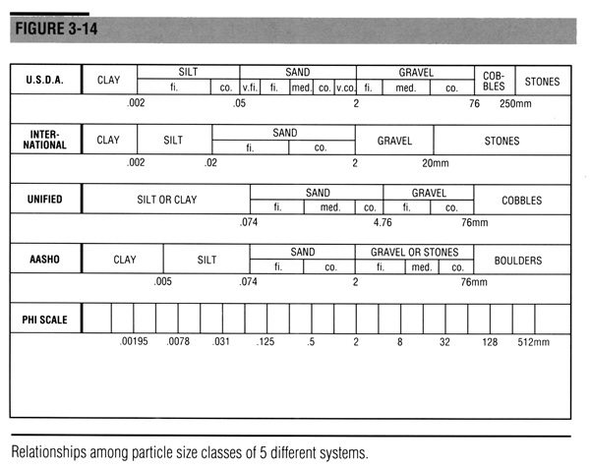
Particle Size Classes

Slide 3
Unified Soil Classification System
  Percent Fines
  Mechanical Analysis
  Liquid Limit
  Plastic Limit, Plasticity Index
  Water Content
  Organic

Slide 4
Background
The Unified Soil Classification System was an outgrowth of the Airfield Classification System
Grouping is based on engineering properties

Slide 5
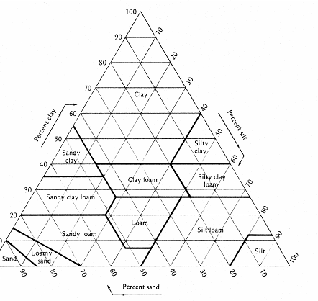
Textural Classification
Textural System only considers grain size.
Clay mineralogy and how it affects water holding and plasticity characteristics are not evaluated with this classification system

Slide 6
Engineering Properties
Permeability
Shear Strength
Consolidation
Shrink/Swell

Slide 7
Parameters Used in Classification System
Particle Size
Water Holding and Plasticity
Organic Content

Slide 8
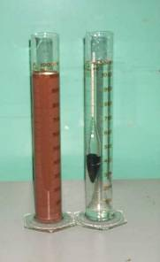
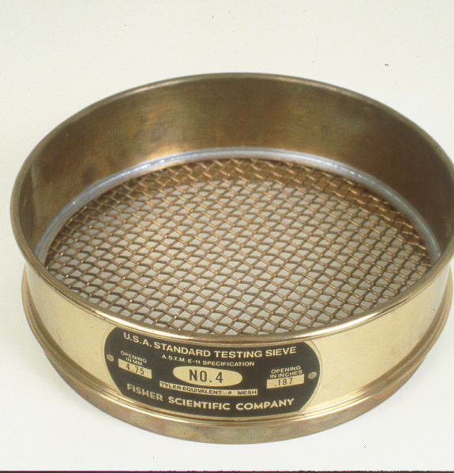
Sieve Analysis Definitions
Particle Sizes
  Gradation or Mechanical Analyses
  Sieves for larger particles
  Hydrometer for fine particles

Slide 9
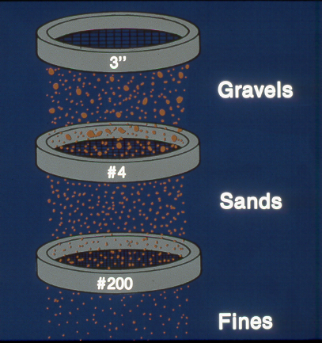
Sieve Analyses

Slide 10
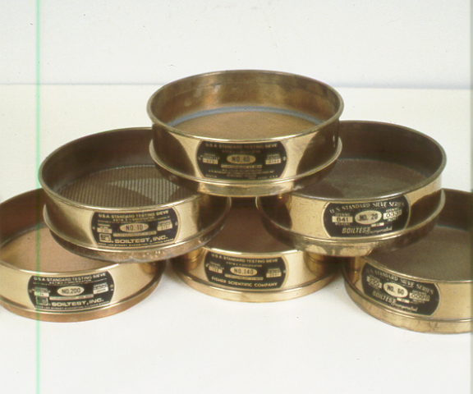
Sieve Analysis

Slide 11
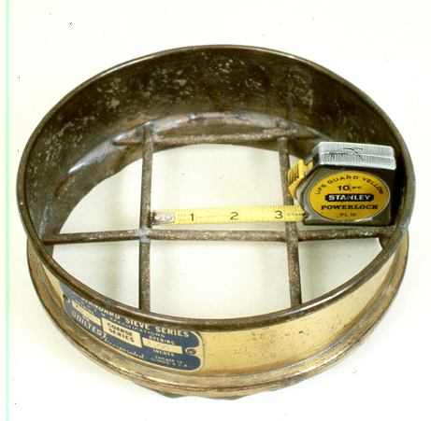
Sieve Designation - Large
Sieves larger than the #4 sieve are designated by the size of the openings in the sieve

Slide 12
Sieve Designation - Smaller
Smaller sieves are numbered according to the number of openings per inch
10 openings per inch
1-inch
# 10 sieve

Slide 13
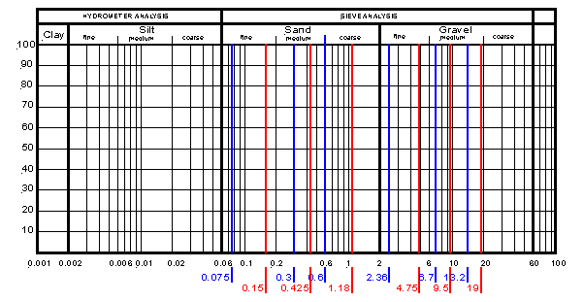
Sieve Analysis
Particle size distribution
The results of a sieve analysis on a soil sample are:
Particle size distribution chard

Slide 14
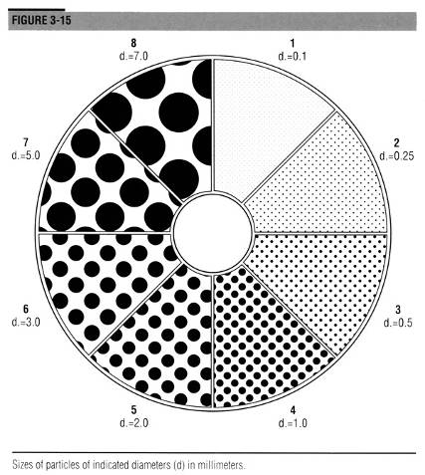
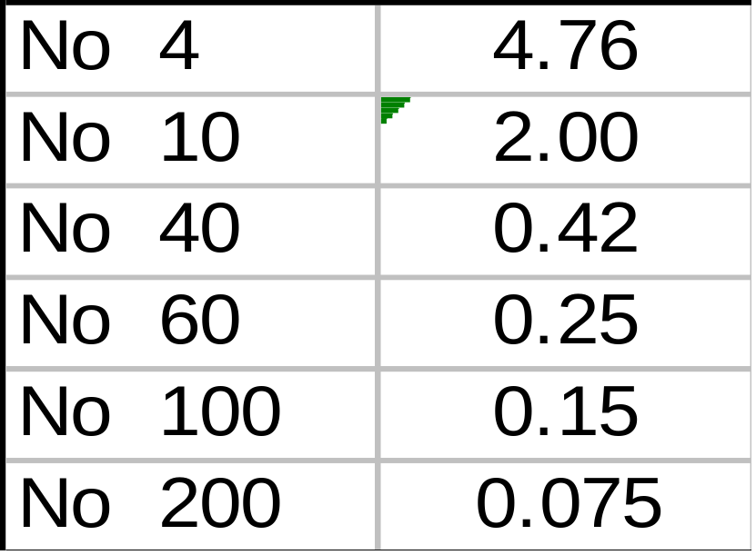
Sieve Numbers (#)

Slide 15
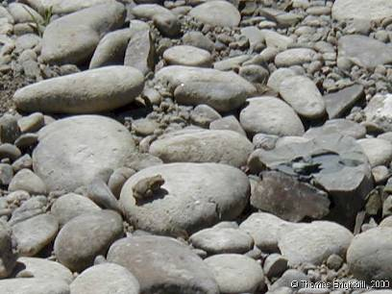
Particle Size Definition
System based only on particles smaller than 75 mm
Cobbles
are 75 to 305 mm
Boulders
are > 305 mm

Slide 16
Gravel / Sand / Fines
Gravels are between # 4 sieve
Sands are between # 200 sieve and
# 4 sieve
Fines are smaller than # 200 sieve

Slide 17
Parameters Used in Classification System
Particle Size
Water Holding and Plasticity
Organic Content

Slide 18
Tests to Define Boundaries
Water Content – Definition
  Ratio of the weight of water in a sample to the weight of the dry soil
  Expressed as a percentage
  Values greater than 100 % possible

Slide 19
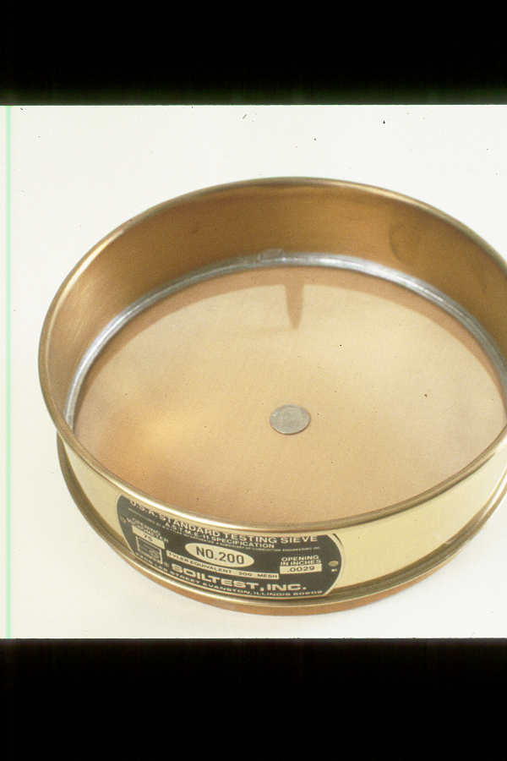
Tests to Define Boundaries
Tests are only performed on the fraction of a sample that is finer than the # 40 sieve.

Slide 20
Liquid Limit Definition
The water content at which a soil changes from a plastic consistency to a liquid consistency
Defined by Laboratory Test concept developed by Atterberg in 1911.

Slide 21
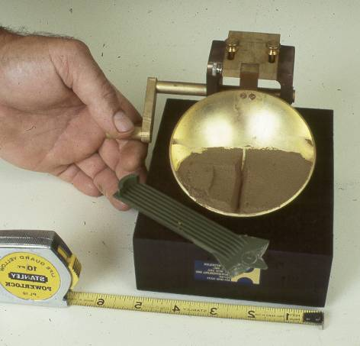
Liquid Limit Definition
The water content at which a groove cut in a soil paste will close upon 25 repeated drops of a brass cup with a rubber base

Slide 22
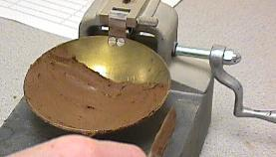
LL Test Procedure
Prepare paste of soil finer than # 40 sieve
Place Soil in Cup

Slide 23
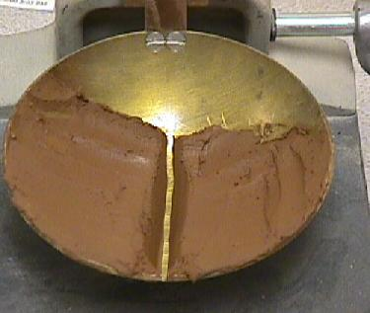
LL Test Procedure
Cut groove in soil paste with standard grooving tool

Slide 24
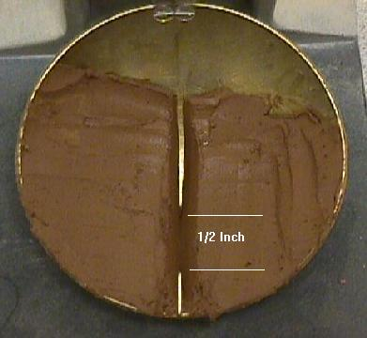
LL Test Procedure
Rotate cam and count number of blows of cup required to close groove by 1/2”

Slide 25
LL Test Procedure
Perform on 3 to 4 specimens that bracket 25 blows to close groove
Obtain water content for each test
Plot water content versus number of blows on semi-log paper

Slide 26
LL Test Results
Interpolate LL water content at 25 blows
Log N
25
LL= w%
water content, %

Slide 27
LL Values < 16 % not realistic
PI, %
Liquid Limit, %
16

Slide 28
LL Values > 50 - HIGH
PI, %
H
Liquid Limit, %
50

Slide 29
LL Values < 50 - LOW
PI, %
L
Liquid Limit, %
50

Slide 30
Plastic Limit Definition
The water content at which a soil changes from a plastic consistency to a semi-solid consistency
Defined by Laboratory Test concept developed by Atterberg in 1911.

Slide 31
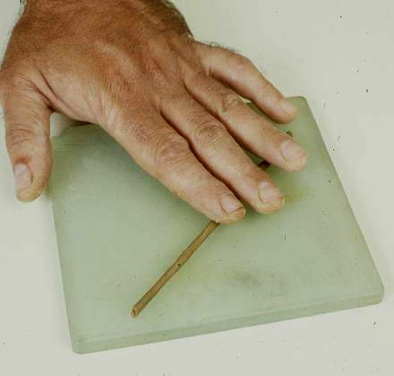
Plastic Limit Definition - Activity 11
The water content at which a 3 mm thread of soil can be rolled out but it begins to crack and cannot then be re-rolled

Slide 32
Plastic Limit w% procedure
Using paste from LL test, begin drying
May add dry soil or spread
on plate and air-dry
Occasionally evaluate 1/8” thread

Slide 33
Plastic Limit w% procedure
When point is reached where thread is cracking and cannot be re-rolled to 1/8” diameter, collect at least 6 grams and measure water content. Defined plastic limit

Slide 34
Definition of Plasticity Index
Plasticity Index is the numerical difference between the Liquid Limit w% and the Plastic Limit w%
PL
w%
LL
PI = LL - PL

Slide 35
Definition of Plasticity Index
It represents the range in water contents over which a soil behaves in a plastic manner
PL
w%
LL
semi-solid
PI = LL - PL
liquid
plastic (remoldable)

Slide 36
Definition of Nonplastic
If the soil has a PI of zero, or either of the Atterberg tests cannot be performed, the soil is said to be non-plastic

Slide 37
Definition of Plasticity
Plastic soils plot above the A-Line on a Chart
Plastic Soils
A - Line

Slide 38
Definition of Plasticity
Non-plastic or slightly plastic soils plot below the A-Line on a Chart
A -Line
Nonplastic Soils

Slide 39
U-Line Significance
U - Line
Correct tests never plot above U-line and LL values are never
< 16
Unrealistic
A -Line
16

Slide 40
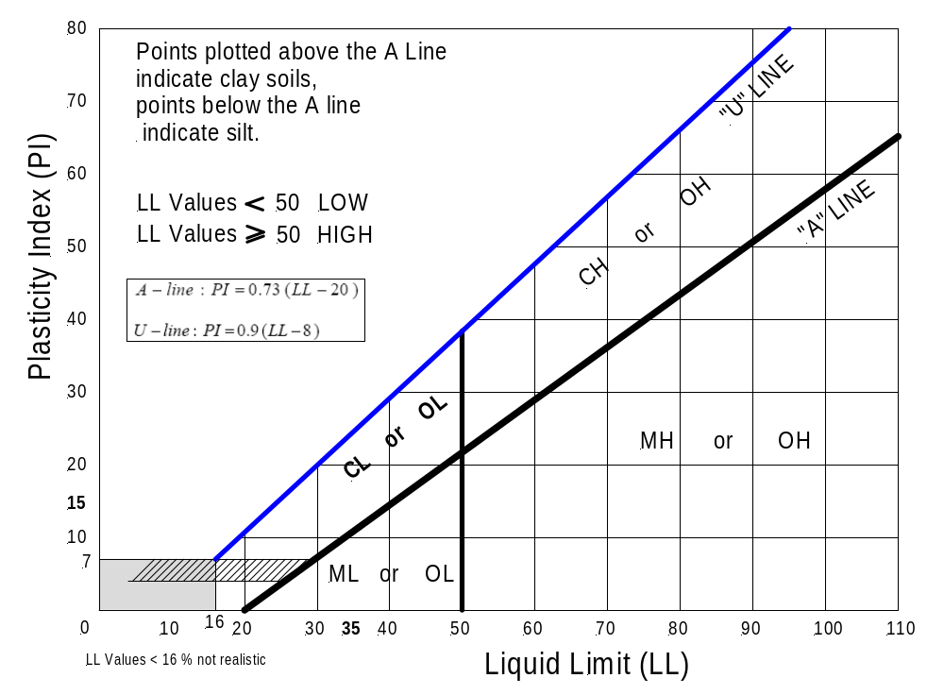
Casagrande's Plasticity Chart

Slide 41
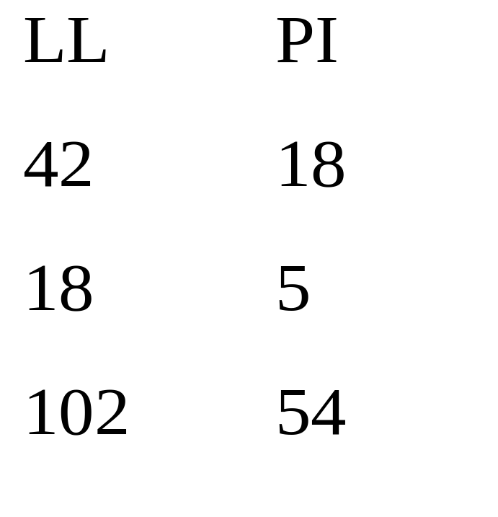
Example Plot of LL, PI
Plastic or Not ??

Slide 42
Criterion for Organic Designation
A liquid limit test is performed on:
  One sample that is only air-dried
  On another that is oven-dried prior to testing
  The liquid limit values are compared by computing the ratio of the 2 values

Slide 43
Organic Definition
If the ratio of the oven-dried soil’s LL to the air-dry soil’s LL values is < 0.75, the soil is organic by definition.
If the air-dry LL is 50 or more, it is a HIGH liquid limit
If the air-dry LL is less than 50, the soil has a LOW LL value

